Slide 1







Working with Data
Data Binding, Validation, Cache, Sessions, Files, AutoMapper
SoftUni Team
Technical Trainers
Software University
http://softuni.bg

Slide 2
Table of Contents
Model Binding
Custom Model Binding
Model Validation
Custom Model Validation
Session, Cache & TempData
Working with Files
Repository Pattern

Slide 3
Have a Question?
sli.do #csharp-web

Slide 4

Model Binding

Slide 5
Model Binding
Model binding in ASP.NET Core MVC maps data from HTTP requests to action method parameters.
The parameters may be primitive types or complex types
Implemented abstractly, paving the way for reusability in different apps
The framework binds request data to action parameters by name
The value of each parameter will be searched, using the parameter name
Classes are mapped using the names of the public settable properties
Request URL
PostsController
https://mysite.com/posts/edit/6
public IActionResult Edit(int? id)

Slide 6
Model Binding
Model binding can look through several data sources per Request
Form values – POST Request parameters
Route values – The set of Route values provided by the Routing
Query strings – The query string parameters in the URL
Data from these sources are stored as name-value pairs
The framework checks each of the data sources for a parameter value
If there is no parameter in the data source, the next in order is checked
The data sources are checked in the order specified above

Slide 7
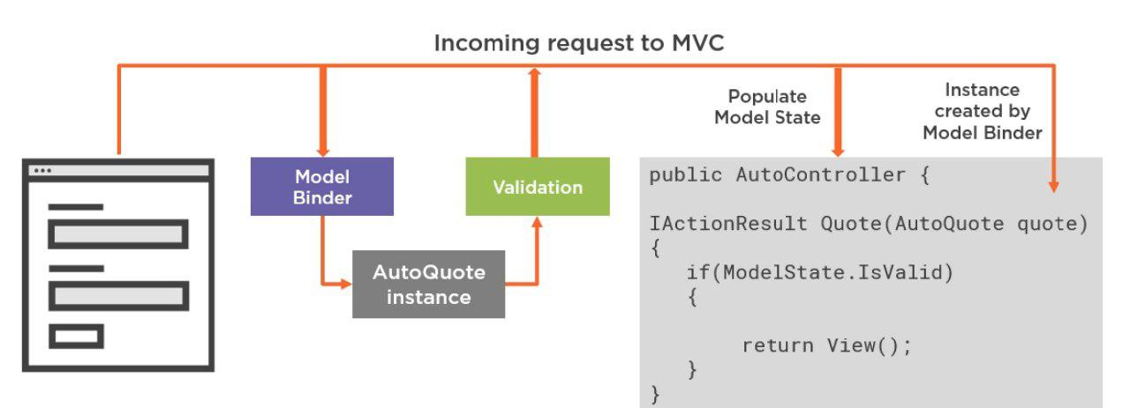
Model Binding

Slide 8
Model Binding
If binding fails, the framework does not throw an error
Every action, accepting user input, should check if binding was successful
This is done through the ModelState.IsValid property
Each entry in the controller’s ModelState property is a ModelStateEntry
Each ModelStateEntry contains an Errors property
It’s rarely necessary to query this collection, though
Default Model binding works great for most development scenarios
It is also extensible, and you can customize the built-in behavior

Slide 9


Model Binding
You can easily iterate over the errors in the ModelState
public class UsersController : Controller
{
public IActionResult Register(RegisterUserBindingModel model)
{
if(!ModelState.IsValid)
{
foreach (var error in ModelState.Values.SelectMany(v => v.Errors))
{
DoSomething(error);
}
// TODO: Return Error Page
}
return Ok("Success!");
}
}

Slide 10
Model Binding
Built-in Model binding behavior can be directed to a different source
The framework provides several attributes for that
Attribute | Description
[BindRequired] | Adds a model state error if binding cannot occur.
[BindNever] | Thells the model binder to never bind this parameter.
[From{source}] | Used to specify the exact binding source. [FromHeader], [FromQuery], [FromRoute], [FromForm]
[FromServices] | Uses dependency injection to bind parameters from services.
[FromBody] | Use configure formatters to bind data from request body. Formatter is selected based on Content-Type of Request.
[ModelBinder] | Used to override the default model binder, binding source and name.

Slide 11

Custom Model Binder
Custom Model Binding can be completely customized
You need to create a BindingProvider and a Binder
[ModelBinder(BinderType = typeof(StudentEntityBinder))]
public class Student
{
public int Id { get; set; }
public string Name { get; set; }
public int Age { get; set; }
}
public class StudentEntityBinder : IModelBinder
{
public Task BindModelAsync (ModelBindingContext bindingContext)
{
//TODO: Do Magic ...
bindingContext.Result
= ModelBindingResult.Success(model);
return Task.CompletedTask;
}
}

Slide 12
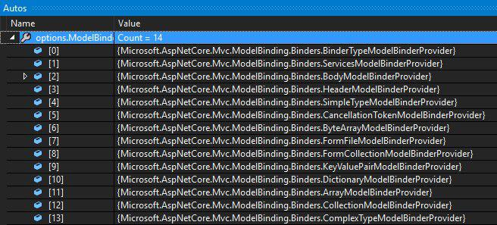
Custom Model Binder
public class StudentEntityBinderProvider : IModelBinderProvider
{
public IModelBinder GetBinder(ModelBinderProviderContext context)
{
if(context == null) throw new ArgumentNullException(nameof(context));
if(context.Metadata.ModelType == typeof(Student))
return new BinderTypeModelBinder(typeof(StudentEntityBinder));
return null;
}
}
public void ConfigureServices(IServiceCollection services)
{
services.AddMvc(options =>
{
options.ModelBinderProviders
.Insert(0, new StudentEntityBinderProvider()); // Add custom binder to beginning
});
}

Slide 13



Model Validation
Once Model binding is complete, Validation occurs

Slide 14
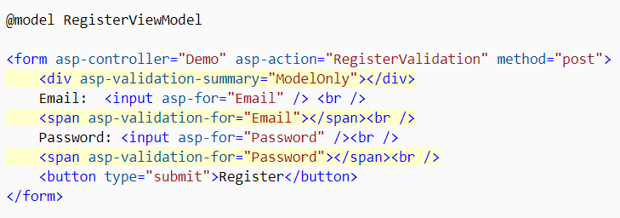
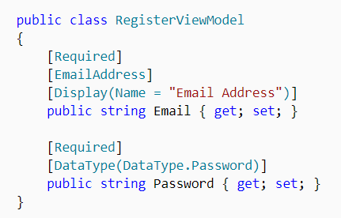
Model Validation
Validation is absolutely necessary before persisting data
The may be potential security threats
There may be malformed data (type, size, data constraints)
In ASP.NET Core MVC, validation happens both on client and server

Slide 15
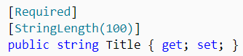
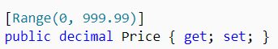
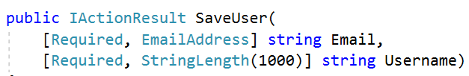
Model Validation
.NET provides us an abstracted validation through attributes
Some attributes configure model validation by constraint
Similar to validation on database fields
Other apply patterns to data to enforce business rules
Credit Cards, Phone Numbers, Email Addresses etc.
Validation attributes make enforcing these requirements simple
They are specified at the property or parameter level

Slide 16
Model Validation
Some of the most popular built-in validation attributes are:
Attribute | Description
[CreditCard] | Validates the property has a credit card format
[Compare] | Validates 2 properties in a model match. (Useful for password confirmation)
[EmailAddress] | Validates the property has an email format.
[Phone] | Validates the property has a telephone format.
[Range] | Validates the property value falls within the given range.
[RegularExpression] | Validates the data matches the specified regular expression.
[Required] | Makes the property required. Value cannot be null.
[StringLength] | Validates that a string property has at most the given maximum length.
[Url] | Validates the property has a URL format.

Slide 17
Custom Model Validation
Validation attributes work for most needs, but not for all
Sometimes you need to implement your own validation attributes
public class IsBefore : ValidationAttribute
{
private const string DateTimeFormat = "dd/MM/yyyy";
private readonly DateTime date;
public IsBefore(string dateInput)
{
this.date = DateTime.ParseExact(dateInput, DateTimeFormat, CultureInfo.InvariantCulture);
}
protected override ValidationResult IsValid(object value, ValidationContext validationContext)
{
if ((DateTime)value >= this.date) return new ValidationResult(this.ErrorMessage);
return ValidationResult.Success;
}
}

Slide 18
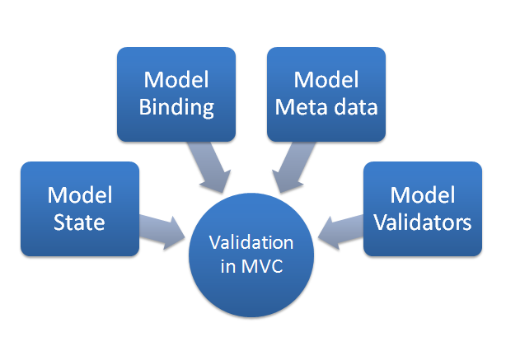
Custom Model Validation
Then you can use it in your model
public class RegisterUserModel
{
[Required]
public string Username { get; set; }
[Required]
[StringLength(20)]
public string Password { get; set; }
[Required
public string FirstName { get; set; }
[Required
public string LastName { get; set; }
[IsBefore("01/01/2000")]
public DateTime BirthDate { get; set; }
}

Slide 19
Custom Model Validation
You can also use validation directly in the Binding Model
This is done by using the IValidatableObject interface
public class RegisterUserModel : IValidatableObject
{
public string Username { get; set; }
public string Password { get; set; }
public string ConfirmPassword { get; set; }
public IEnumerable<ValidationResult> Validate(ValidationContext validationContext)
{
if(string.IsNullOrEmpty(Username)) yield return new ValidationResult("Username cannot be empty");
if(string.IsNullOrEmpty(Password)) yield return new ValidationResult("Password cannot be empty");
if(ConfirmPassword != Password) yield return new ValidationResult("Passwords do not match");
}
}

Slide 20
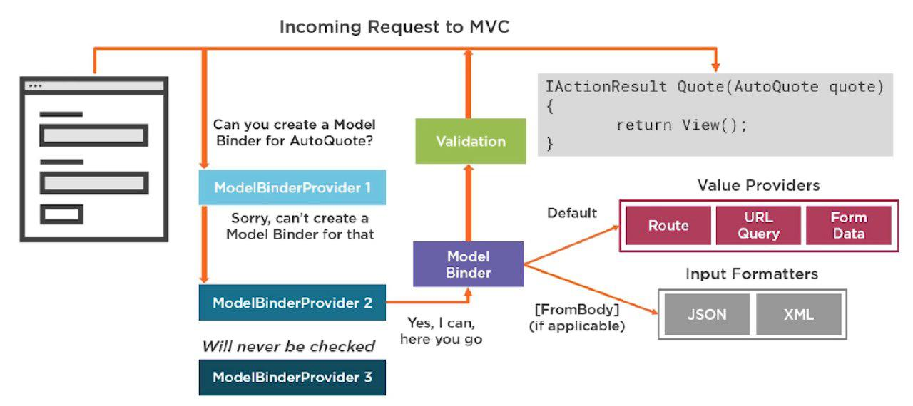
Model Binding & Model Validation

Slide 21

Sessions, Cache & TempData
Application State

Slide 22


Sessions
Session state is an ASP.NET Core scenario for storage of client data
Each client has a unique Session ID which the framework stores
Data can be maintained while the client browsers the application
Session data is backed by cache, and is considered ephemeral
The application should continue to function without session data

Slide 23
Sessions
Enabling Session middleware, setting up in-memory session provider
public void ConfigureServices(IServiceCollection services)
{
services.AddDistributedMemoryCache(); // Default in-memory cache
services.AddSession(options =>
{ options.IdleTimeout = TimeSpan.FromSeconds(10); // Set a short timeout for easy testing
options.Cookie.HttpOnly = true; // Some XSS security (Niki will explain)
});
services.AddMvc();
}
public void Configure(IApplicationBuilder app, IHostingEnvironment env)
{
...
app.UseSession(); // UseSession() Middleware must be before UseMvc()
app.UseMvc();
}

Slide 24
Sessions
After the Session state is configured, HttpContext.Session is available
ASP.NET Core Sessions store byte array values to ensure serialization
You may need specific approaches in order to store complex data
public IActionResult GetShoppingCart()
{
if (this.HttpContext.Session.Get("Cart") == null)
{
this.HttpContext.Session.SetString("Cart", JsonConvert.SerializeObject(new Cart()));
}
this.ViewData["Cart"] = this.HttpContext.Session.GetString("Cart") == null
? null
: JsonConvert.DeserializeObject(this.HttpContext.Session.GetString("Cart"));
return View();
}

Slide 25
Sessions
You can implement Session Extension methods to ease your work
public static class SessionExtensions
{
public static void Set<T>(this ISession session, string key, T value)
{
session.SetString(key, JsonConvert.SerializeObject(value));
}
public static T Get<T>(this ISession session, string key)
{
var value = session.GetString(key);
return value == null ? default(T)
: JsonConvert.DeserializeObject<T>(value);
}
}

Slide 26

Working with Sessions
Live Demo

Slide 27

TempData
ASP.NET Core exposes the TempData property in:
Razor Page page models
MVC Controllers
The property stores data until it’s read
Keep() and Peek() methods avoid deletion when data is examined
TempData is:
Particularly used for redirection
When data is required for more than a single request

Slide 28
TempData
TempData is implemented by TempData providers
Using either Cookies or Session State
As of ASP.NET Core 2.0, the default TempData provider is cookie-based
public void ConfigureServices(IServiceCollection services)
{
services.AddMvc().AddSessionStateTempDataProvider();
services.AddSession(...);
}
public void Configure(IApplicationBuilder app, IHostingEnvironment env)
{
...
app.UseSession();
app.UseMvc();
}

Slide 29

TempData
After enabling the TempData, you can access it in:
Your Controller, and Actions
Your Razor Page page model
public IActionResult RedirectToTempData()
{
this.TempData["Previous"] = "/Home/RedirectToTempData";
return this.RedirectToAction("AccessTempData");
}
public IActionResult AccessTempData()
{
this.HttpContext.Response.Headers.Add("Previous", this.TempData["Previous"].ToString());
// Add a HttpHeader ("Previous") with the previous Action URL.
return this.View();
}

Slide 30
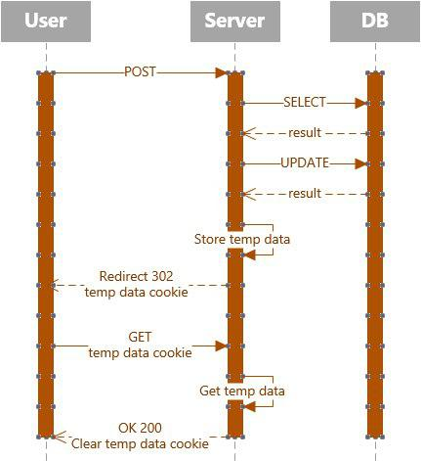
TempData

Slide 31
Cache
An efficient way to store data

Slide 32
Cache
Cache makes a copy of a piece of data and stores it
Can be extracted much faster than from its original source
Significantly improves application performance
Works best with data that does not change frequently
ASP.NET Core supports several different caches
The simplest cache is based on the IMemoryCache
An in-memory cache stored on the app Server’s memory
Can store any type – primitive or complex (object)

Slide 33

Cache
In-memory Cache is configured as a simple service
public void ConfigureServices(IServiceCollection services)
{
services.AddMemoryCache(); // Add the IMemoryCache as a dependency to the DI
services.AddMvc();
}
public class HomeController : Controller
{
private IMemoryCache cache;
public HomeController(IMemoryCache memoryCache)
{
this.cache = memoryCache; // Inject the IMemoryCache through DI
}
...
}

Slide 34
Cache
Here is an example of a cache DateTime value
public IActionResult GetCachedData()
{
DateTime cacheEntry;
if (!this.cache.TryGetValue(CacheKeys.Entry, out cacheEntry)) // Look for cache key.
{
cacheEntry = DateTime.Now; // Key not in cache, so get data.
var cacheEntryOptions = new MemoryCacheEntryOptions() // Set cache options.
.SetSlidingExpiration(TimeSpan.FromSeconds(3)); // Keep in cache for this time.
// Reset time if accessed.
// Save data in cache.
this.cache.Set(CacheKeys.Entry, cacheEntry, cacheEntryOptions);
}
return View("Cache", cacheEntry);
}

Slide 35
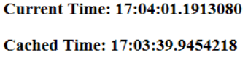

Cache
The cached DateTime value remains in the cache
Its value is untouched, from the moment of caching
There are requests within the timeout period
No eviction is done due to memory pressure
<h3>Current Time: @DateTime.Now.TimeOfDay.ToString()</h3>
<h3>Cached Time: @(Model == null ? "No cached entry found" : Model.Value.TimeOfDay.ToString())</h3>

Slide 36
Cache
The framework also supplies you with a convenient Tag Helper
The Cache Tag helper caches content to the internal cache provider
<cache>
Current Time: @DateTime.Now
</cache>
<cache expires-on="@new DateTime(2025,1,29,17,02,0)">
Current Time: @DateTime.Now
</cache>
<cache enabled="true">
Current Time: @DateTime.Now
</cache>
<cache expires-after="@TimeSpan.FromSeconds(120)">
Current Time: @DateTime.Now
</cache>
<cache expires-sliding="@TimeSpan.FromSeconds(60)">
Current Time Inside Cache Tag Helper: @DateTime.Now
</cache>

Slide 37
Working with Cache
Live Demo

Slide 38

Files
Uploading and Downloading files

Slide 39

Uploading Files
ASP.NET Core MVC supports File Upload using simple model binding
For larger files, Streaming is used
Multiple-file upload is also supported
<form method="post" enctype="multipart/form-data"
asp-controller="Files" asp-action="Upload">
<input type="file" name="file"> <button type="submit" value="Upload" />
</form>
<form method="post" enctype="multipart/form-data" asp-controller="Files" asp-action="Upload">
<input type="file" name="files" multiple > <button type="submit" value="Upload" />
</form>

Slide 40


Uploading Files
When uploading files using model binding, your action should accept:
IFormFile (for single file) or IEnumerable<IFormFile> (or List<IFormFile>)
[HttpPost("Upload")]
public async Task<IActionResult> Upload(List<IFormFile> files)
{
var filePath = Path.GetTempFileName(); // Full path to file in temp location
foreach (var formFile in files.Where(f => f.Length > 0))
{
using (var stream = new FileStream(filePath, FileMode.Create))
{
await formFile.CopyToAsync(stream);
}
} // Copy files to FileSystem using Streams
return Ok(new { count = files.Count, files.Sum(f => f.Length), filePath});
}

Slide 41




Downloading Files
ASP.NET Core abstracts file system access through File Providers
File Providers are used throughout the ASP.NET Core framework
Examples of where ASP.NET Core uses File Providers internally
IHostingEnvironment exposes the app’s content root and web root
Static File Middleware uses File Providers to locate static files
Razor uses File Providers to locate pages and views

Slide 42
Downloading Files
To access physical files, you have to use PhysicalFileProvider
You’ll have to initialize it with your server physical files folder path
Then you can extract information about the File
public IActionResult Download(string fileName)
{
// Construct the path to the physical files folder
string filePath = this.env.ContentRootPath + this.config["FileSystem:FilesFolderPath"];
IFileProvider provider = new PhysicalFileProvider(filePath); // Initialize the Provider
IFileInfo fileInfo = provider.GetFileInfo(fileName); // Extract the FileInfo
var readStream = fileInfo.CreateReadStream(); // Extact the Stream
var mimeType = "application/octet-stream"; // Set a mimeType
return File(readStream, mimeType, fileName); // Return FileResult
} // NOTE: There is no check if the File exists. This action may result in an error

Slide 43

Repository Pattern
Abstracting the data access logic

Slide 44
Repository Pattern
Repositories are components that encapsulate data access logic
They centralize common data access functionality
They provide better maintainability and testability
They decouple the data access infrastructure from the Domain layer
For each aggregate, you should define one Repository
Repositories, basically, allow you to populate data in-memory
Data is mapped from database to Domain Entities
Once in-memory, entities can be changed and persisted back

Slide 45


Repository Pattern
Normally you implement specific Interface-Class pairs.
There are other ways, though. Like Generic Repositories, for example
public interface IStudentRepository
{
void SaveStudent(Student student);
IEnumerable<Student> GetAllStudents();
Student GetStudent(long id);
void DeleteStudent(long id);
void UpdateStudent(Student student);
}
public class StudentRepository : IStudentRepository
{
private ApplicationContext context;
private DbSet<Student> studentEntity;
public StudentRepository(ApplicationContext context)
{
this.context = context;
this.studentEntity = context.Set<Student>();
}
public void SaveStudent(Student student) { ... }
public IEnumerable<Student> GetAllStudents() { ... }
public Student GetStudent(long id) { ... }
public void DeleteStudent(long id) { ... }
public void UpdateStudent(Student student) { ... }
}

Slide 46

Summary
Model Binding
Custom Model Binding
Model Validation
Custom Model Validation
Session, Cache & TempData
Working with Files
Repository Pattern
…
…
…

Slide 47
https://softuni.bg/trainings/courses

Slide 48













SoftUni Diamond Partners

Slide 49





SoftUni Organizational Partners

Slide 50




Trainings @ Software University (SoftUni)
Software University – High-Quality Education and Employment Opportunities
softuni.bg
Software University Foundation
http://softuni.foundation/
Software University @ Facebook
facebook.com/SoftwareUniversity
Software University Forums
forum.softuni.bg

Slide 51

License
This course (slides, examples, demos, videos, homework, etc.) is licensed under the "Creative Commons Attribution-NonCommercial-ShareAlike 4.0 International" license

